Slide 1
Advanced Data Analysis Joining Time Series
Emanuele Della Valle
Prof. @ Politecnico di Milano
Founder & Partner @ Quantia Consulting
Marco Balduini
Founder & CEO @ Quantia Consulting
Riccardo Tommasini
Prof. @ University of Tartu

Slide 2
Exploring Flux Joining Time Series

Slide 3
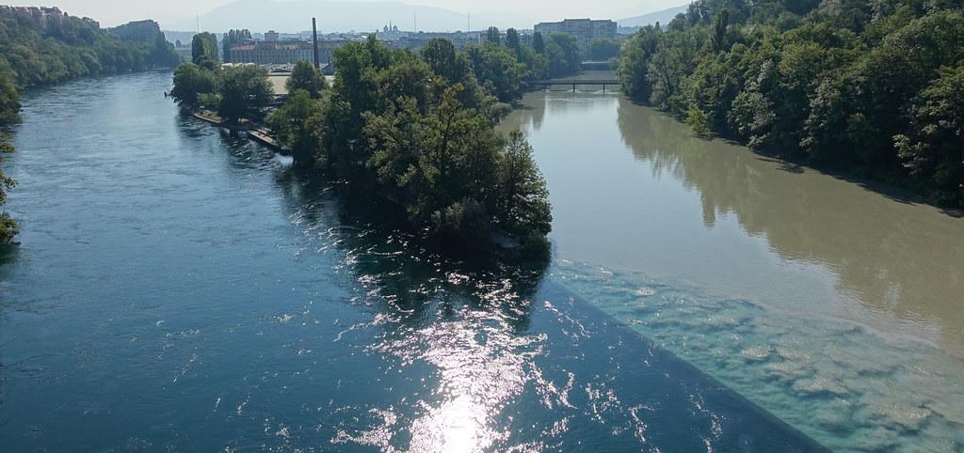
Joining two time series
Joining two time series

Slide 4
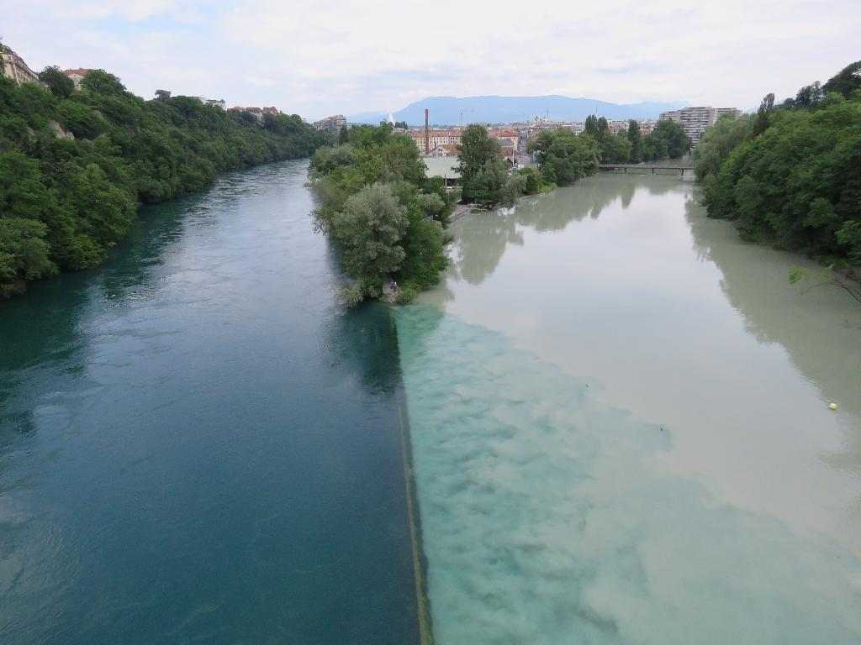
The ideal case
The Ideal Scenario

Slide 5
Running example on pizza quality issues
If the temperature difference between the base cooking area and the mozzarella melting area is lower than 180° or greater than 190°, the mozzarella cheese will not melt properly or it will burn.

Slide 6

305
290
285
S1
280
280
00:00
01:00
02:00
03:00
04:00
120
105
110
S2
100
95
00:00
01:00
02:00
03:00
04:00
S1-S2
185
185
185
185
170
00:00
01:00
02:00
03:00
04:00

Slide 7
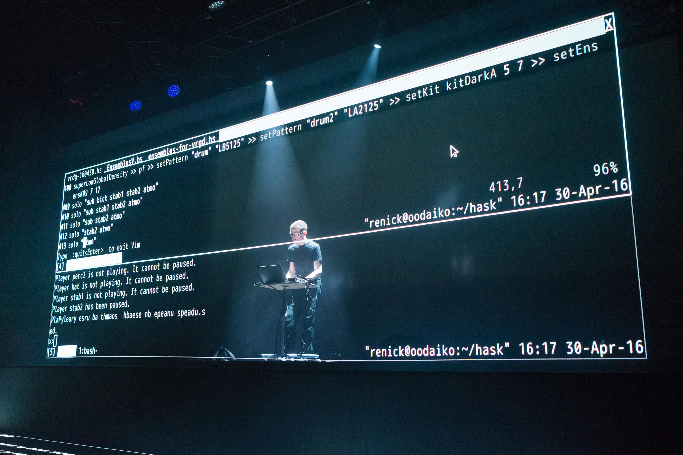
Let’s do some live coding

Slide 8
Here we go
ts12 = from(bucket: "training")
|> range(start: 2020-06-07T12:00:00Z, stop: 2020-06-07T12:05:00Z)
|> filter(fn: (r) => r._measurement == "iot-oven")
|> filter(fn: (r) => r._field == "temperature")
ts1 = ts12 |> filter(fn: (r) => r.sensor == "S1")
ts2 = ts12 |> filter(fn: (r) => r.sensor == "S2")
join(tables: {key1: ts1, key2: ts2}, on: ["_time"], method:inner")
join |> map(fn: (r) => ({ _time: r._time,
_value: r._value_s1 - r._value_s2 }))

Slide 9
It gives no results … why?
:-/

Slide 10
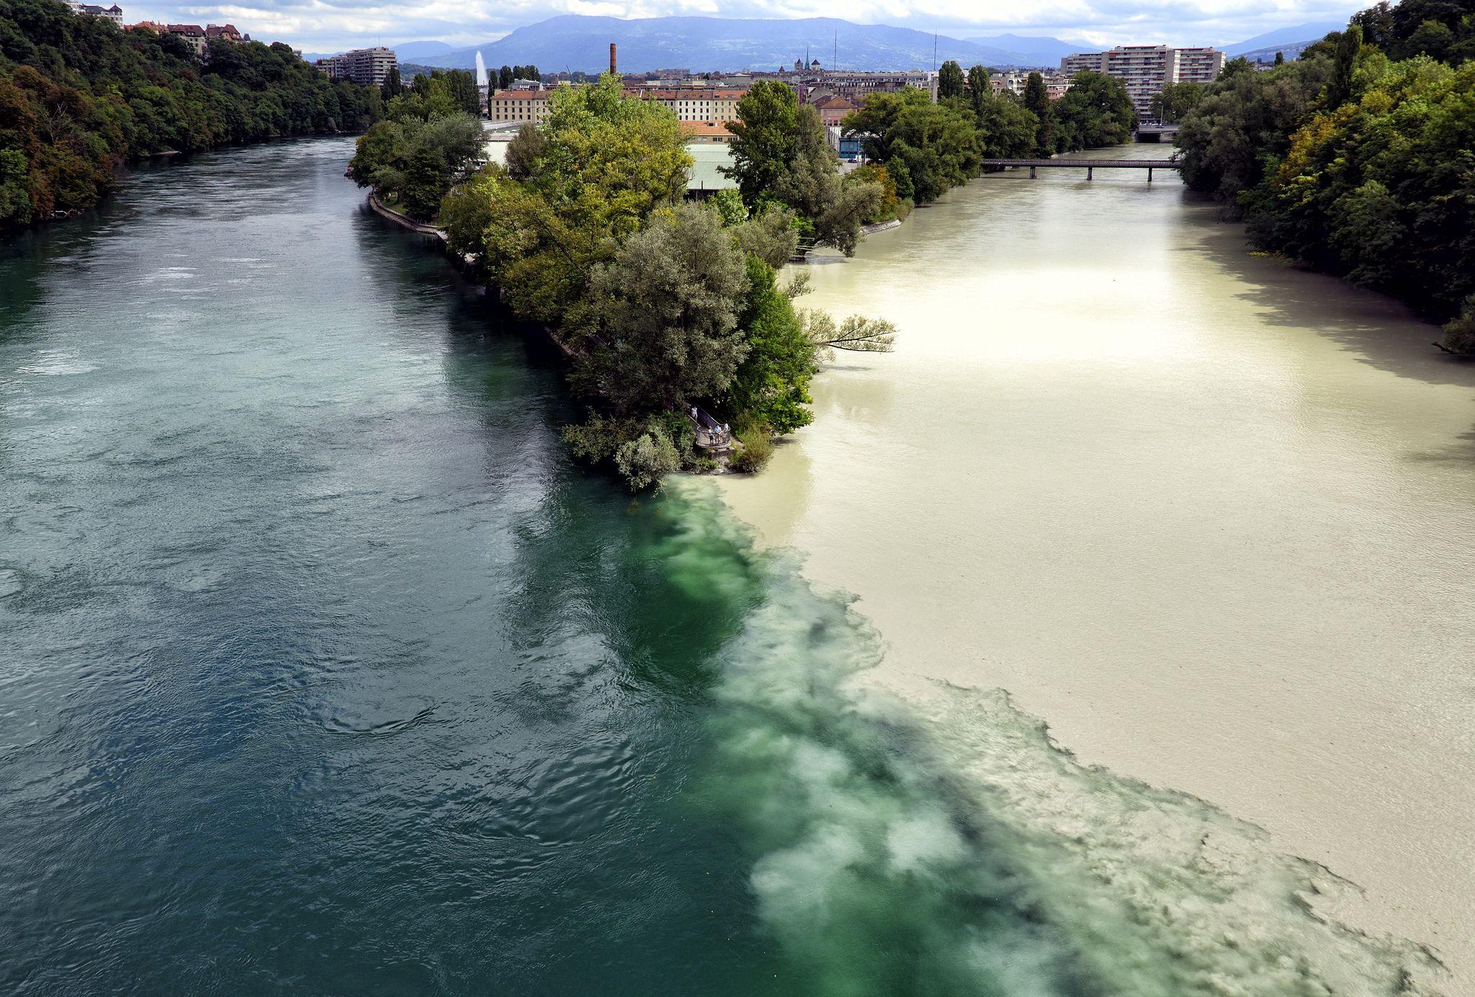
The reality is always more difficult than expected

Slide 11
A close look to the distribution of our data over time
305
290
285
S1
280
280
00:00
01:00
02:00
03:00
04:00
120
115
115
105
110
110
S2
100
95
90
00:15
00:45
01:15
01:45
02:15
02:45
03:15
03:45
04:15
Notes:
Time shift
ma ci sono riuscito solo perchè potevo ispezionare I dati
trunchiamo?
Valori multipli|!!!
E allora?
aggregate window

Slide 12
A close look to the distribution of our data over time
305
290
285
S1
280
280
00:00
01:00
02:00
03:00
04:00
120
115
115
105
110
110
S2
100
95
90
00:15
00:45
01:15
01:45
02:15
02:45
03:15
03:45
04:15
NOTE: S1 and S2 are not synchronized: metrics don’t occur at the same time and rate
Notes:
Time shift
ma ci sono riuscito solo perchè potevo ispezionare I dati
trunchiamo?
Valori multipli|!!!
E allora?
aggregate window

Slide 13
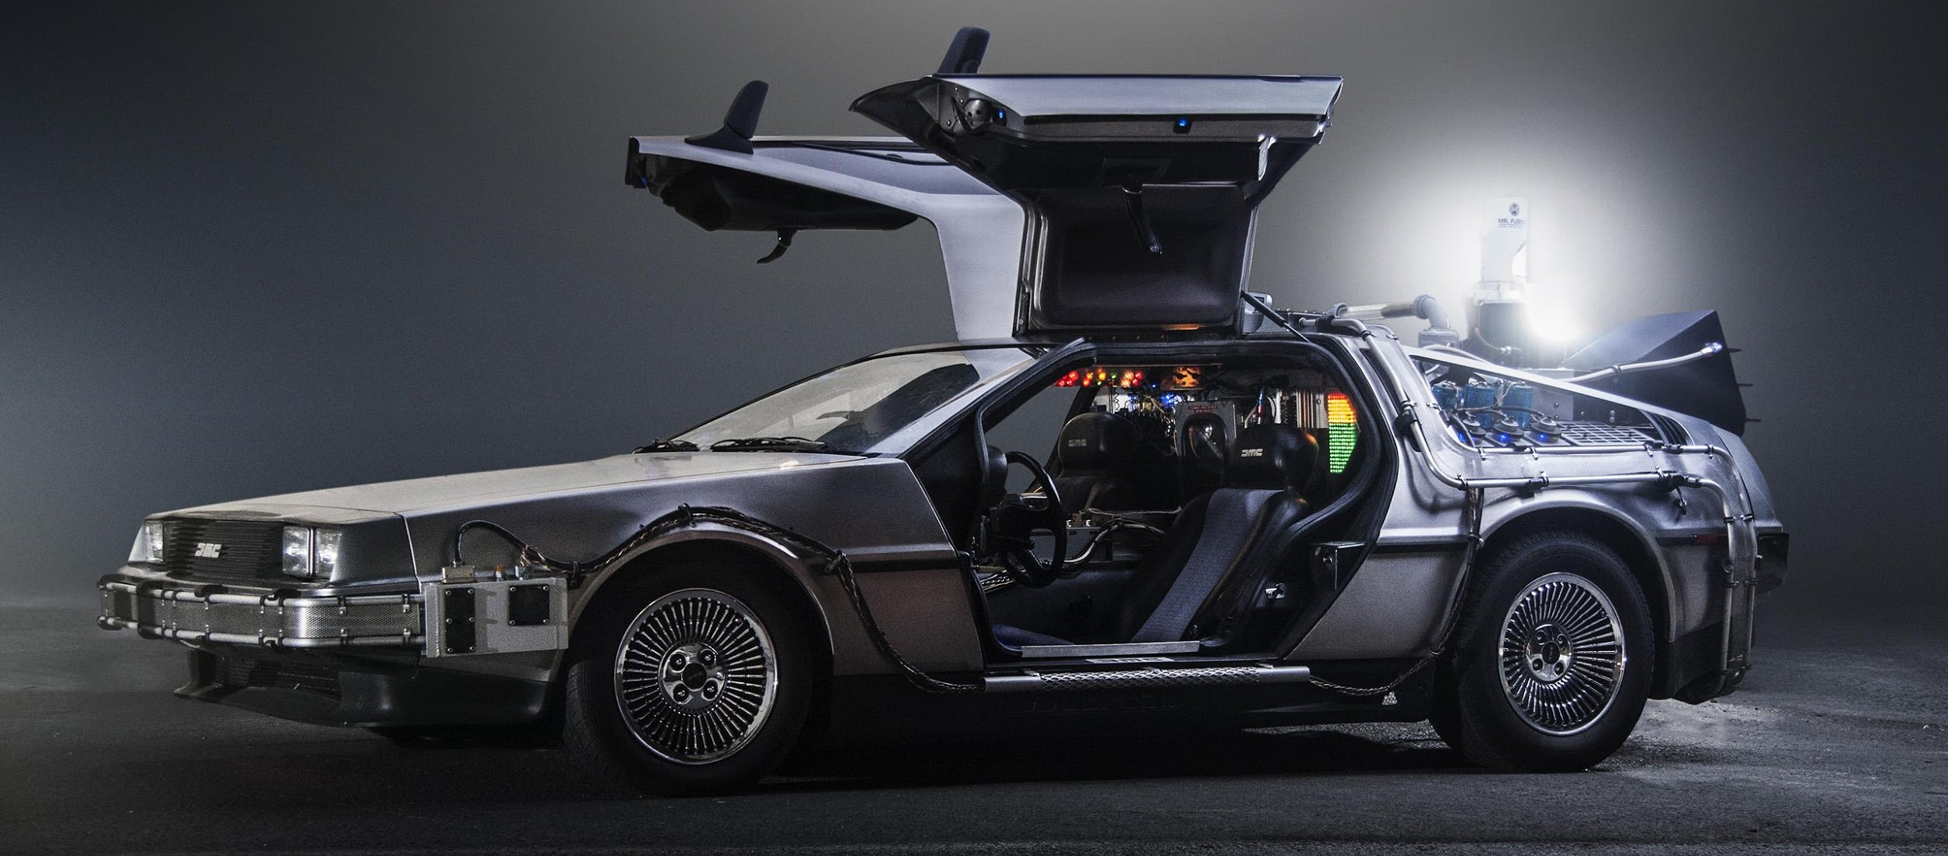
Can we synchronize them? Let’s do a time shift!

Slide 14
Can we synchronize them with a time shift?
305
290
285
S1
280
280
00:00
01:00
02:00
03:00
04:00
120
115
115
105
110
110
S2
100
95
90
00:15
00:45
01:15
01:45
02:15
02:45
03:15
03:45
04:15

Slide 15
Can we synchronize them with a time shift?
305
290
285
S1
280
280
00:00
01:00
02:00
03:00
04:00
120
115
115
105
110
110
S2
-15 sec
100
95
90
00:15
00:45
01:15
01:45
02:15
02:45
03:15
03:45
04:15

Slide 16
Here we go
temp = from(bucket: "training")
|> range(start: v.timeRangeStart, stop: v.timeRangeStop)
|> filter(fn: (r) => r._measurement == "iot-oven")
|> filter(fn: (r) => r._field == "temperature")
tempS1 = temp |> filter(fn: (r) => r.sensor == "S1")
tempS2 = temp |> filter(fn: (r) => r.sensor == "S2")
|> timeShift(duration: 15s, columns: ["_time"] )
temp_join = join( tables: {s1:tempS1, s2: tempS2}, on: ["_time"] )
temp_join |> map(fn: (r) => ({ _time: r._time,
_value: r._value_s1 - r._value_s2 }))

Slide 17
Can we synchronize them with a time shift?
305
290
285
S1
280
280
00:00
01:00
02:00
03:00
04:00
120
115
115
105
110
110
S2
100
-15 sec
95
90
00:00
00:30
01:00
01:30
02:00
02:30
03:00
03:30
04:00

Slide 18
Can we synchronize them with a time shift?
305
290
285
S1
280
280
00:00
01:00
02:00
03:00
04:00
120
115
115
105
110
110
S2
100
-15 sec
95
90
00:00
00:30
01:00
01:30
02:00
02:30
03:00
03:30
04:00
NOTE: some metrics now occur at the same time, but the rate is still different

Slide 19
Moreover, is -15 sec correct? Shall I do -30 sec, instead?
:-/

Slide 20

Shall we tumble?

Slide 21
Can we synchronize them with a tumbling window?
305
290
285
S1
280
280
00:00
01:00
02:00
03:00
04:00
120
115
115
105
110
110
S2
100
95
90
00:15
00:45
01:15
01:45
02:15
02:45
03:15
03:45
04:15
NOTE: S1 and S2 are not synchronized: metrics do not occur nor at the same to nor rate

Slide 22
Can we synchronize them with a tumbling window?
305
290
285
S1
280
280
00:00
01:00
02:00
03:00
04:00
120
115
115
105
110
110
S2
100
95
90
00:15
00:45
01:15
01:45
02:15
02:45
03:15
03:45
04:15
NOTE: S1 and S2 are not synchronized: metrics do not occur nor at the same to nor rate

Slide 23
Can we synchronize them with a tumbling window?
305
290
285
S1
280
280
00:00
01:00
02:00
03:00
04:00
120
115
115
105
110
110
S2
100
95
90
00:15
00:45
01:15
01:45
02:15
02:45
03:15
03:45
04:15
NOTE: S1 and S2 are not synchronized: metrics do not occur nor at the same to nor rate

Slide 24
Here we go
temp = from(bucket: "training")
|> range(start: 2020-04-30T10:00:00Z, stop: 2020-04-30T10:05:00Z)
|> filter(fn: (r) => r._measurement == "iot-oven")
|> filter(fn: (r) => r._field == "temperature")
tempS1 = temp |> filter(fn: (r) => r.sensor == "S1")
|> aggregateWindow(every: 60s, fn: mean)
tempS2 = temp |> filter(fn: (r) => r.sensor == "S2")
|> aggregateWindow(every: 60s, fn: mean)
temp_join = join( tables: {s1:tempS1, s2: tempS2}, on: ["_time"] )
temp_join |> map(fn: (r) => ({ _time: r._time,
_value: r._value_s1 - r._value_s2 }))

Slide 25
It works!
:-)

Slide 26
Bonus point: tumbling windows also synchronize events!
305
290
285
S1
280
280
00:09
01:06
02:04
03:02
04:07
120
115
115
105
110
110
S2
100
95
90
00:12
00:46
01:21
01:39
02:17
02:36
03:16
03:48
04:18
MENO: events are irregular time series

Slide 27
Bonus point: tumbling windows also synchronize events!
305
290
285
S1
280
280
00:09
01:06
02:04
03:02
04:07
120
115
115
105
110
110
S2
100
95
90
00:12
00:46
01:21
01:39
02:17
02:36
03:16
03:48
04:18
MENO: events are irregular time series

Slide 28
Bonus point: tumbling windows also synchronize events!
305
290
285
S1
280
280
00:09
01:06
02:04
03:02
04:07
120
115
115
105
110
110
S2
100
95
90
00:12
00:46
01:21
01:39
02:17
02:36
03:16
03:48
04:18
MENO: events are irregular time series

Slide 29

Quiz
Which synchronization method shall you use before joining? none | timeShift | aggregateWindow
one timeseries is regular, but the other is not - ?
two timeseries are regular, have the same rate, but metrics occur at a different time - ?
two timeseries are regular, have the same rate, and metrics occur at the same time - ?
two timeseries are irregular - ?
two timeseries are regular, but metrics don't occur at the same time and rate - ?

Slide 30
Quiz answers
Which synchronization method shall you use before joining? none | timeShift | aggregateWindow
one timeseries is regular, but the other is not - aggregateWindow
two timeseries are regular, have the same rate, but metrics occur at a different time - ?
two timeseries are regular, have the same rate, and metrics occur at the same time - ?
two timeseries are irregular - ?
two timeseries are regular, but metrics don't occur at the same time and rate - ?

Slide 31
Quiz answers
Which synchronization method shall you use before joining? none | timeShift | aggregateWindow
one timeseries is regular, but the other is not - aggregateWindow
two timeseries are regular, have the same rate, but metrics occur at a different time - timeShift
two timeseries are regular, have the same rate, and metrics occur at the same time - ?
two timeseries are irregular - ?
two timeseries are regular, but metrics don't occur at the same time and rate - ?

Slide 32
Quiz answers
Which synchronization method shall you use before joining? none | timeShift | aggregateWindow
one timeseries is regular, but the other is not - aggregateWindow
two timeseries are regular, have the same rate, but metrics occur at a different time - timeShift
two timeseries are regular, have the same rate, and metrics occur at the same time - none
two timeseries are irregular - ?
two timeseries are regular, but metrics don't occur at the same time and rate - ?

Slide 33
Quiz answers
Which synchronization method shall you use before joining? none | timeShift | aggregateWindow
one timeseries is regular, but the other is not - aggregateWindow
two timeseries are regular, have the same rate, but metrics occur at a different time - timeShift
two timeseries are regular, have the same rate, and metrics occur at the same time - none
two timeseries are irregular - aggregateWindow
two timeseries are regular, but metrics don't occur at the same time and rate - ?

Slide 34
Quiz answers
Which synchronization method shall you use before joining? none | timeShift | aggregateWindow
one timeseries is regular, but the other is not - aggregateWindow
two timeseries are regular, have the same rate, but metrics occur at a different time - timeShift
two timeseries are regular, have the same rate, and metrics occur at the same time - none
two timeseries are irregular - aggregateWindow
two timeseries are regular, but metrics don't occur at the same time and rate - aggregateWindow

Slide 35

Let’s get dirty!
8

Slide 36
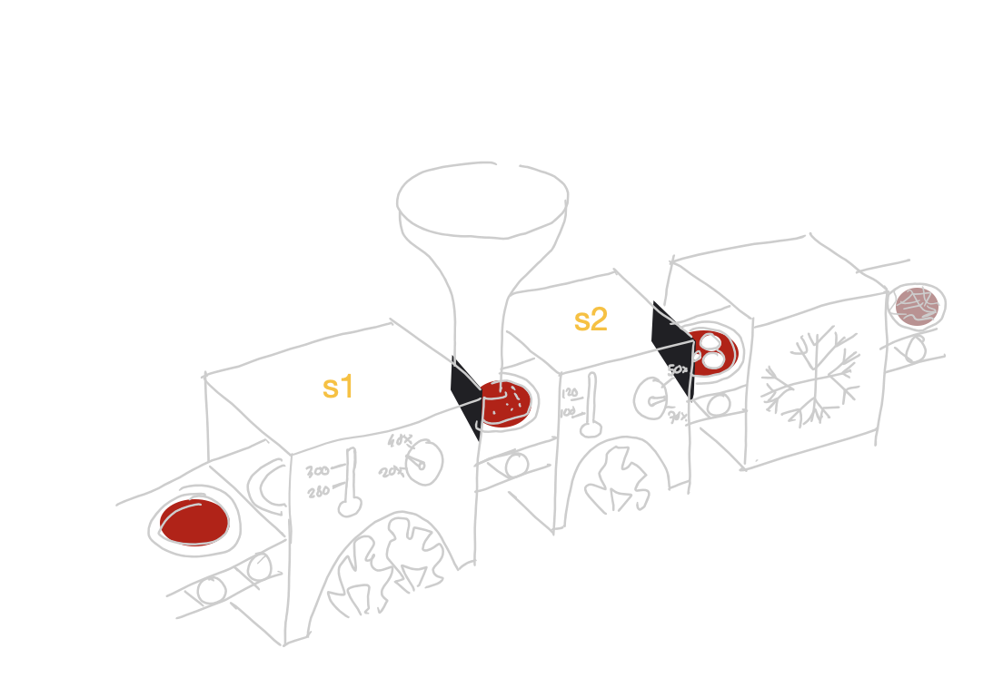
Continuous Linear Pizza Oven
Learning goals:
Join data

Slide 37
Task
Extract the difference between the humidity levels of the base cooking area and the mozzarella melting area. Find if the differences are lower than 20% or greater than 30%

Slide 38
Let’s do some live coding

Slide 39
Advanced Data Analysis Joining Time Series
Emanuele Della Valle
Prof. @ Politecnico di Milano
Founder & Partner @ Quantia Consulting
Marco Balduini
Founder & CEO @ Quantia Consulting
Riccardo Tommasini
Prof. @ University of Tartu

